Slide 1

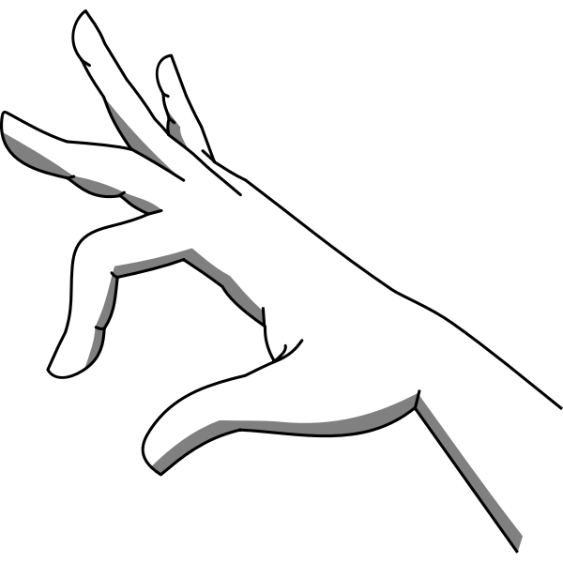
Volume control using Gesture recognition
Final OOP project by M.Dawood Arslan

Slide 2


Purpose:
The main purpose of this project was to recognize basic gestures in order to increase and or decrease the volume of a systems current speaker.
Two distinct methods were used to approach this problem(libraries and language used will be discussed later).
The first method was abandoned due to issues which will be discussed later.

Slide 3


1. The contour method
This method can be broken down into three core steps.
Find the hand This required cleaning up and removing any data we don't need
Find its contours and fingers In order to figure out where the fingers are.
Use fingertips To gauge the distance between each finger tip in order to determine the specific gesture we are looking for

Slide 4
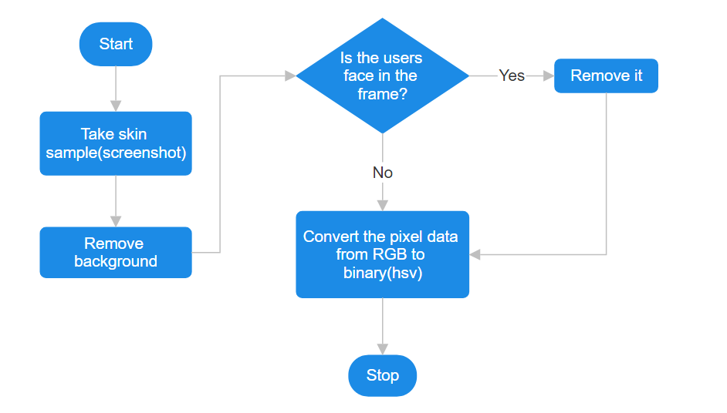
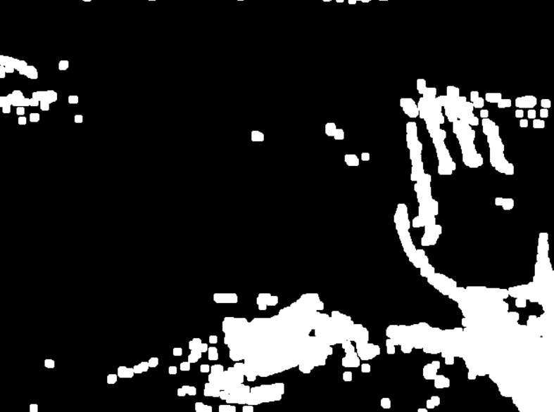
How did you find the hand?
In essence, all you have to do is take a skin sample screenshot and remove every other pixel that doesn't come within a certain threshold of the RGB value. Hand would come out looking like the image below,however the program would still not know what to do with the given data.
(this example in particular is bad due to the issue in hostel lighting and the walls being the same color as my skintone)

Slide 5
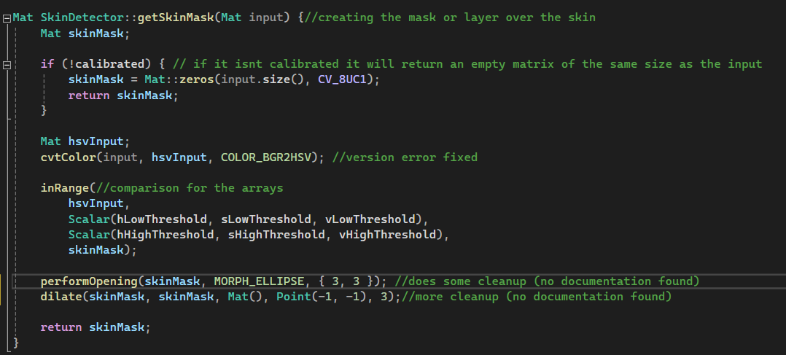
Snippets of some code (skin detection in particular)

Slide 6
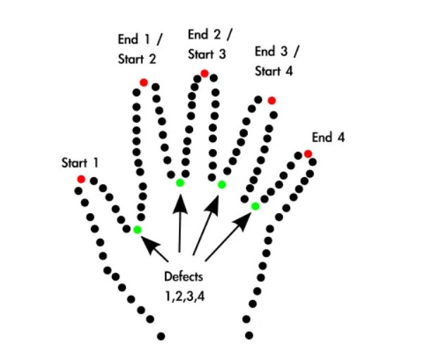
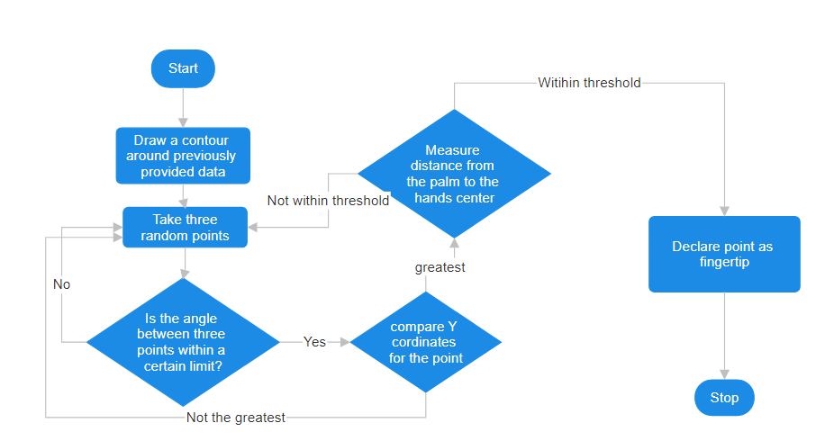
What about the fingers?
This was the tricky part, the fingers were detected by using a purely mathematical approach.

Slide 7

Using the finger tips
Why you may ask?
Fingertips were detected but were not consistent enough to use
Differentiating particular fingers proved impossible
Gesture detection was out of the question as the data from the webcam was not clean enough
This is where approach 1 died

Slide 8

What then?

Slide 9

2. Using Opencv to its full potential
So far, OpenCV was only being used to gather and manipulate data from our camera
Create a wireframe of the hand Why bother putting in effort when opencv has an inbuilt machine learning database tailor made for detecting hands
Use the points on the wireframe Since we just want the distance between two points in particular we can ignore most of the hand

Slide 10

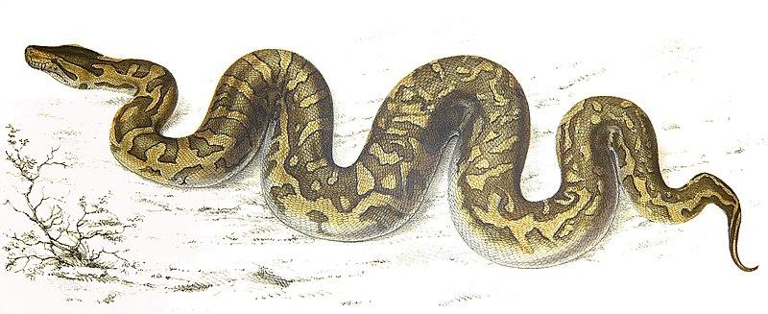
Before we continue
Why?
This approach was attempted using C++,however the C++ port of OpenCV was not optimised enough to handle the task.The output was 1 frame every 2.86 seconds as opposed to Python which gave a crisp 30 frames per second.
From this point onwards, Python will be used as opposed to C++

Slide 11
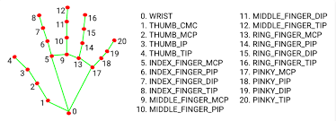
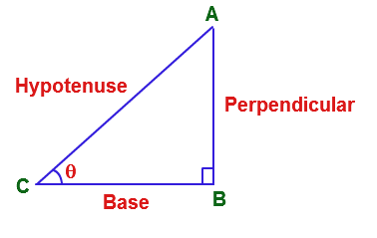
How to detect the wireframe and what to do with it?
To create a wireframe we first use inbuilt Opencv functions to detect certain points on a hand.
In particular we use point 8 and 4 as we need the distance between the tips of the thumb and the index finger.
The distance is found by finding the hypotenuse of the difference between point 4 and 8’s x and y coordinates.
The value of said distance is then used to alter the speakers volume.

Slide 12
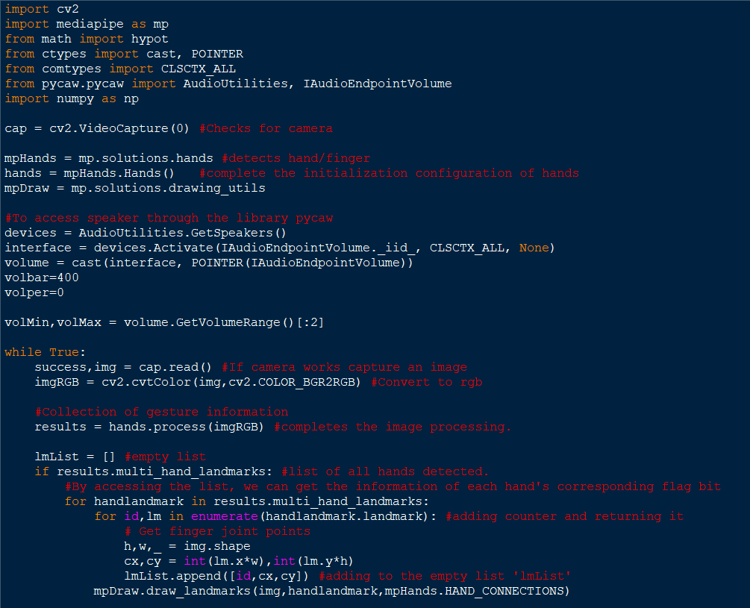
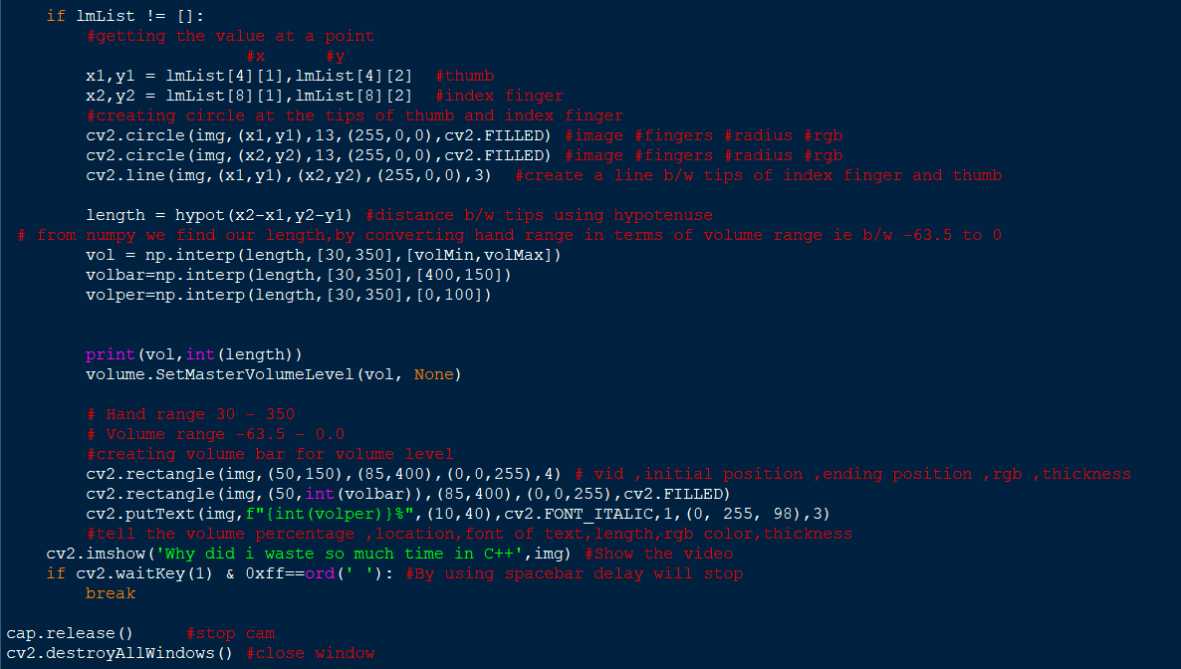
Here’s the entire code because python is easy
Keep in mind that the C++ implementation of approach 1 required 4 separate header and cpp files (not including the main file)

Slide 13
Demo

Slide 14
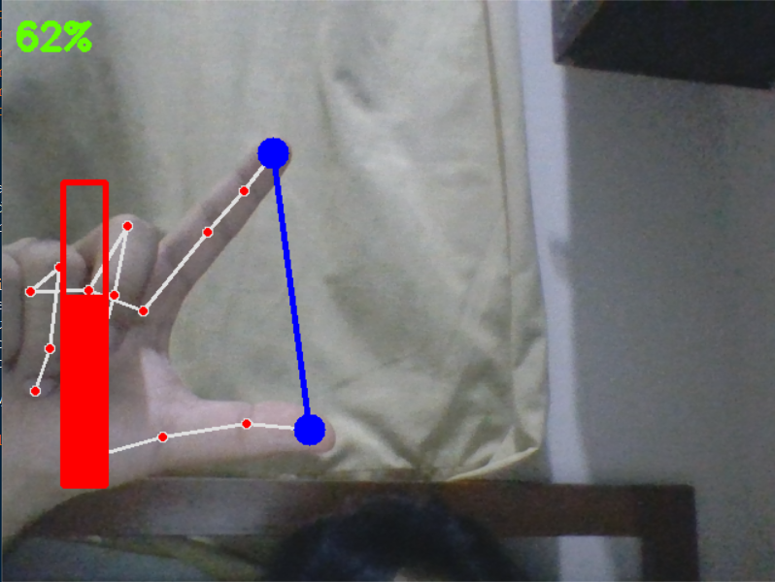
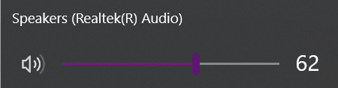
Here’s an example of the output

Slide 15
Outcomes
Better understanding of C++ and python Since i essentially implemented the same code twice in two different languages, i have a better grasp of their differences.
Gained experience in debugging code I had to fix many niche errors and gained many insights,such as how to interpret garbage return values.

Slide 16
References
Approach 1 https://pierfrancescoi.medium.com/hands-detection-a6e3cec1
Approach 2 https://www.computervision.zone

Slide 17
Thank you for your time

